Slide 1
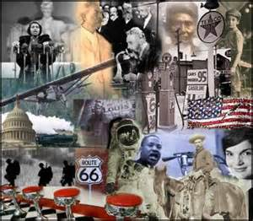
U.S. History E.O.C.T Part V Modern Era

Slide 2
Domain V Standards 21 - 25
Impact of technological development and economic growth in the U.S. between 1945-1975.
Civil Rights Movement
Political developments between 1945-1970
Social-change movements and organizations of the 1960s.
Political developments after 1968.

Slide 3
Technological Development &
Economic Growth in the U.S. between 1945-1975
Standard 21

Slide 4
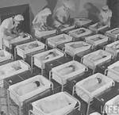
Economic Growth
After WWII, soldiers returned home to America and settled back into the lives they had left behind.
One effect of this was a huge growth population, called the baby boom.
The birthrate quickly increased, reaching a high point in 1957, over 4 million babies were born that year.

Slide 5
The generation referred to as “baby boomers” is the largest generation in American History.

Slide 6
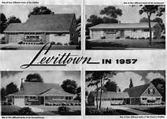
Levittown
Another effect of soldiers’ return was a housing shortage.
The veterans and their growing families needed homes to live in.
Housing developer William Levitt created method of building houses, faster, cheaper, and more efficiently.

Slide 7
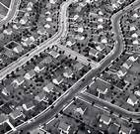
These methods led to the creation of the first suburbs.
Suburbs were communities outside of a city and made up of mostly single-family houses for people whose family members worked in the city.
The first master-planned community in America was William Levitt’s Levittown, located on New York’s Long Island.

Slide 8
Interstate Highway Act
Because the new suburbs were outside the limits of larger cities, there was little public transportation available for suburban residents.
They needed cars, and increased car ownership meant more roads were needed.
Congress passed the Interstate Highway Act, authorizing construction of a national network of highways to connect every major city in America.

Slide 9
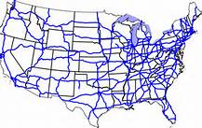
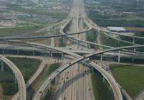
In all, 41,000 miles of new expressways, or freeways, were built.
It was a record-size public works project.

Slide 10
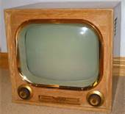
Television Changes America
The first regular television broadcasts began in 1949.
Providing only 2 hours a week of news and entertainment to a very small area on the East Coast.
By 1956, over 500 stations were broadcasting all over America.
News and entertainment were
brought into the living rooms of
most Americans.

Slide 11
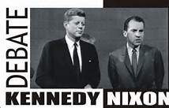
Kennedy/Nixon Presidential Debates
The first presidential debates ever televised, in 1960.
70 million people tuned in.
Although Nixon had more experience in foreign policy, Kennedy looked and spoke more forcefully.
Kennedy’s performance in the debate helped him win the presidency.
This changed the shape of American politics.

Slide 12
Impact of Television
TV newscast changed the shape of American culture.
Americans who might not have never watched a Civil Rights demonstration saw and heard them on their TVs in the 1960s.
TV news coverage of the Civil Rights Movement helped many Americans turn their sympathies toward ending racial segregation

Slide 13
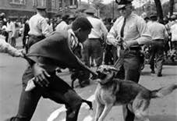
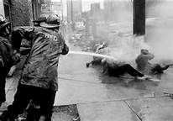
In 1963, TV reports showed the police officers in Birmingham, Alabama, using high-pressure fire hoses to spray African American children who had been walking in protest marches.
The reports also showed the officers setting police dogs to attack them, and clubbing them.
Kennedy realized that new laws were the only ways to end racial violence and to give African Americans the civil rights they were demanding.

Slide 14
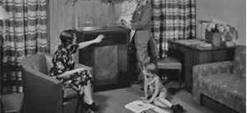
Technological Wonders
The expanded use of air-conditioning permitted more tolerable working conditions in skyscrapers and other buildings used for conducting businesses.
This encouraged urban development and stimulated economic growth in hot and humid climates.

Slide 15
Telephone lines covered the country.
This allowed people to stay in contact regardless of distance.
By the 1970s, early versions of the personal computer, the Internet, and cellular phones gave a few Americans a glimpse into the technologies that someday would connect everyone to each other regardless of where they were.

Slide 16
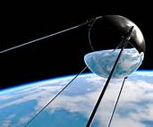
Sputnik I & the Cold War
In 1957, the Soviet Union launched the first artificial satellite–
Sputnik I–a feat that caused many Americans to believe the United
States had “fallen behind” the Soviet Union in terms of understanding
science and the uses of technology.
The success of the Soviet satellite launch led to increased U.S. government spending on education, especially in mathematics and science, and on national military defense programs.
Additionally, Sputnik I increased Cold War tensions by heightening U.S. fears that the Soviet Union might use rockets to launch nuclear weapons against the United States and its allied nations.

Slide 17
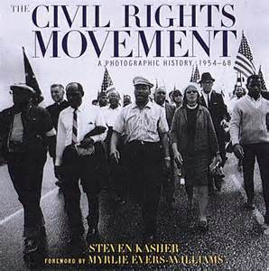
The Civil Rights Movement 1945 – 1970 Standard 22

Slide 18
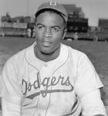
Jackie Robinson, 1947
The first African American to play for a major league baseball team In the U.S., the Brooklyn Dodgers.
This led to a complete integration of baseball and other professional sports.
Robinson was named MVP in 1949, and the first African American in the Baseball Hall of Fame.
Until this time, African Americans played professional baseball in the Negro leagues.

Slide 19
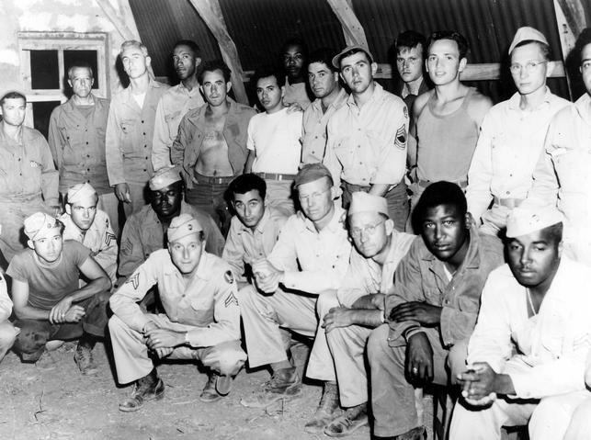
Racial Integration in the Military
1948––President Harry Truman issued an executive order to integrate the U.S. Armed Forces and end discrimination in the hiring of U.S. government employees.
In turn, this led to the civil rights laws enacted in the 1960s.

Slide 20
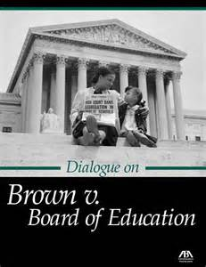
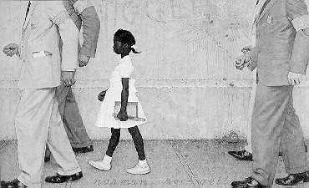
Brown v. Board of Education
1954––In the Brown v. Board of Education case, the U.S. Supreme Court declared that state laws establishing “separate but equal” public schools denied African American students the equal education promised in the 14th Amendment.
The Court’s decision reversed prior rulings dating back to the
Plessy v. Ferguson case in 1896.
Many people were unhappy with this decision, and some even refused to follow it.

Slide 21
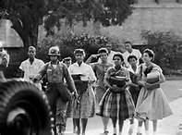
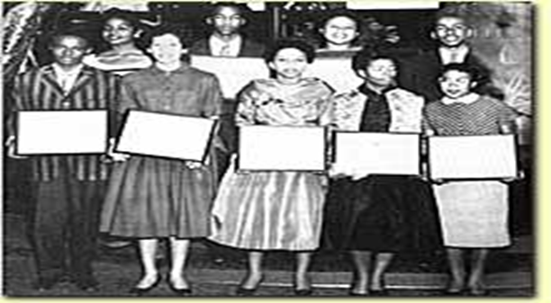
The governor of Arkansas ordered the National Guard to keep nine African American students from attending Little Rock’s Central High School.
President Eisenhower sent federal troops to Little Rock to force the high school to integrate.

Slide 22
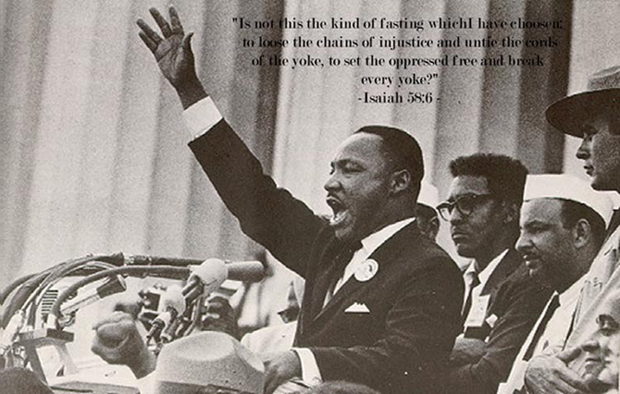
Martin Luther King, Jr., 1963
Martin Luther King, Jr., was arrested in Birmingham, Alabama, while demonstrating against racial segregation.
In jail he wrote his Letter from Birmingham Jail to address fears white religious leaders had that he was moving too fast toward desegregation.
In his letter, King explained why victims of segregation, violent attacks, and murder found it difficult to wait for those injustices to end.
Later the same year, King delivered his most famous speech, I Have a Dream, to over 250,000 people at the Lincoln Memorial in Washington, D.C. In this speech, King asked
for peace and racial harmony.

Slide 23
Civil Rights Act of 1964
1964––The Civil Rights Act of 1964 was signed into law by President Lyndon Johnson.
This law prohibited discrimination based on race, religion, national origin, and gender.
It allowed all citizens the right to enter any park, restroom, library, theater, and public building in the United States.
One factor that prompted this law was the long struggle for civil rights undertaken by America’s African American population.
Another factor was King’s famous I Have a Dream speech; its moving words helped create widespread support for this law.
Other factors were news reports of presidential actions that combated civil rights violations, such as Truman’s in 1948 and Eisenhower’s in 1954, and Kennedy sending federal troops to Mississippi (1962) and Alabama (1963) to force the integration of public universities there.

Slide 24
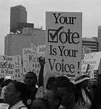
Voting Rights Act of 1965
1965––The outlawed the requirement for would-be voters in the United States to take literacy tests to register to vote because this requirement was judged as unfair to minorities.
The act provided money to pay for programs to register voters in areas with large numbers of unregistered minorities.
Gave Department of Justice the right to oversee the voting laws in certain districts that had used tactics such as literacy tests or poll taxes to limit voting.

Slide 25
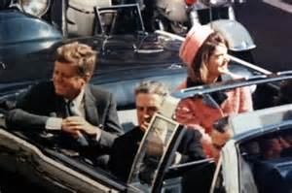
Impact of Political Developments between 1945 -1970 Standard 23

Slide 26
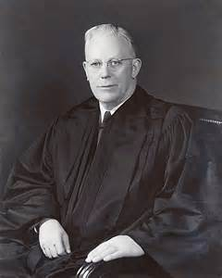
Individual Rights
During most of the 50s & 60s, the U.S Supreme Court was headed by Chief Justice Earl Warren.
The Warren Court became famous for issuing landmark decisions such as:
Brown v. Board of Education
right to free speech protecting student wearing armbands as an antiwar protest on school grounds
all states must obey all decisions of the Supreme Court

Slide 27
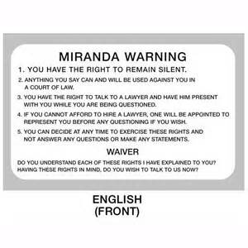
In 1963, The Warren Court issued another landmark decision, Miranda v. Arizona.
Police must inform suspects of their constitutional rights at the time of arrest.
Suspects have the right to remain silent, and the right to an attorney.
The Miranda Decision strengthened American’ individual rights

Slide 28
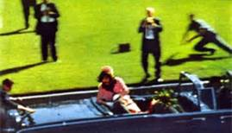
Murder in Dallas
The assassination of President Kennedy in Dallas, TX, in November 1963, was a tragic event with a twofold political impact.

Slide 29
The assassination showed Americans just how strong their government was, although the president could be killed, the U.S. government would live on.
The assassination gave President Johnson, the political capital to force his domestic legislative package through congress.
This included the Economic Opportunity Act of 1964, Johnson’s “War on Poverty”.
Civil Rights Act of 1964, which outlawed segregation in schools and other public places.

Slide 30
Great Society
During a 1964 speech, President Johnson summed up his vision for America in the phrase “the Great Society”.
His programs to make the U.S. a great society would give all Americans a better standard of living and greater opportunities regardless of their background.
The legacy of the great Society.
Medicare Program
Improvements to elementary and secondary education
Environmental protection
Reform immigration policies

Slide 31
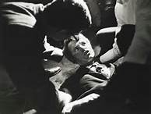
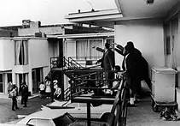
1968
January, Vietcong launched the Tet Offensive during the Vietnam War.
April, assassination of Martin Luther King, Jr.
One week after kings death Congress passed the Civil Right Act of 1968, which prevented discrimination in housing.
June, the assassination of Robert F. Kennedy.
August, the Democratic national Convention in Chicago.
Police armed with clubs and tear gas violently beat antiwar
protesters on live TV.

Slide 32
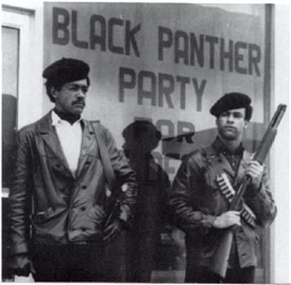
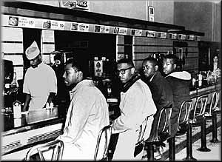
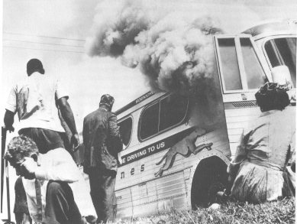
Impact of Social Change Movements and Organizations of the 1960s Standard 24

Slide 33
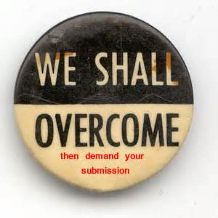
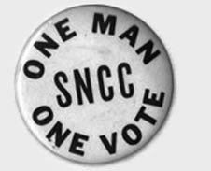
Civil Rights Organizations
Southern Christian Leadership Conference (SCLC)
Student Non-violent Coordinating Committee
(SNCC)

Slide 34
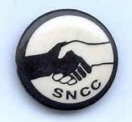
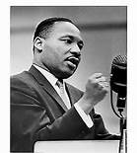
Founding
SCLC -Founded by Martin Luther King, Jr., and other ministers and Civil Rights leaders
SNCC-Founded by African American college students with $800 received from the SCLC
Goal
SCLC - To carry on nonviolent crusades against the evils of second-class citizenship
SNCC -To speed up changes mandated by Brown v. Board of Education

Slide 35
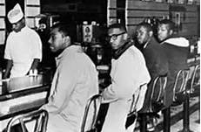
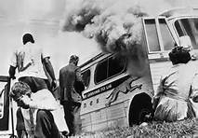
Original Tactics
SCLC -Marches, protests, and demonstrations throughout the South, using churches as bases
SNCC- Sit-ins at segregated lunch counters all across the South
Later Tactics
SCLC -Registering African Americans to vote, in hope they could influence Congress to pass voting rights act
SNCC -Freedom Rides on interstate buses to determine if southern states would enforce laws against segregation in public transportation

Slide 36
Original Membership
SCLC -Average African American adults; white adults
SNCC -African American and white college students; included whites at first, but later it became all-African American organization
Later Membership
SCLC - Same as original membership
SNCC -African Americans only; no whites

Slide 37
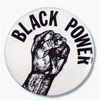
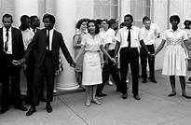
Original Philosophy
SCLC - Nonviolence
SNCC - Nonviolence
Later Philosophy
SCLC - Same as original philosophy. Nonviolence.
SNCC - Militancy and violence; “Black Power” and African-American pride

Slide 38
Anti-Vietnam War Movement
Americans against the war in Vietnam became more vocal in their opposition.
Many groups started on college campuses.
They used many of the same tactics as groups fighting for civil rights, including sit-ins, marches, and demonstrations.
Later, some protesters became more radical;
burning their draft cards
going to prison rather than going to Vietnam
fleeing to Canada

Slide 39
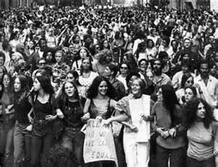
National Organization of Women
The National Organization of Women was founded in 1966 to promote equal rights and opportunities for America’s women.
NOW had its origins in the civil rights and anti-war movements of the early 1960s. In both of these, women felt sidelined by the men who led the organization like SNCC and anti-Vietnam War groups.
NOW’s goals included equality in employment, political, and social equality, and the passage of the Equal Rights Amendment

Slide 40
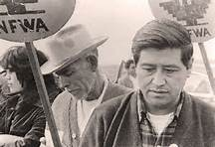
United Farm Workers’ Movement
Latinos also protest to gain civil rights in the 1960s.
Led by César Chávez, an American of Mexican Descent.
Founded the United Farm Workers’ movement.
Chávez believed in nonviolent methods.
He started a nationwide boycott of California grapes, forcing growers to negotiate a contract with the UFW in 1970.
This contract gave farm workers higher
wages and other benefits.

Slide 41
Environmental Movement
Protecting the environment became important to many Americans. Silent Spring, a 1962 book about pesticides by Rachel Carson, exposed dangers to the environment. This book led to the Water Quality Act of 1965.
The first Earth Day was celebrated in 1970, when almost every community across America and over 10,000 schools and 2,000 colleges organized events to raise awareness of environmental issues; Earth Day is still celebrated each year.
Also in 1970, President Nixon created the Environmental Protection Agency (EPA) to set limits on pollution, conduct environmental research, and assist state and local governments clean up polluted sites.

Slide 42
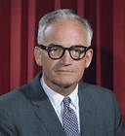
Conservative Movement
Senator Barry Goldwater was running for president, member of the conservative party.
Goldwater believed the government should not try to fix social and economic problems such as poverty, discrimination, or lack of opportunity.
He lost the presidential election of 1964.

Slide 43
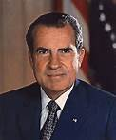
The conservative movement continued with the election of Republican Richard Nixon.
He wanted to replace President Johnson’s Great Society programs with what he called New Federalism.
This would take away some federal government powers, such as social welfare and give them to the state and local governments.

Slide 44
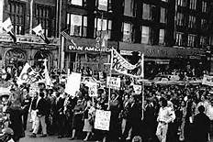
National Politics since 1968 Standard 25

Slide 45
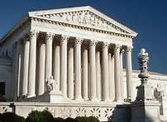
Supreme Court Decisions
The Supreme Court ruled on many cases that would change he perception of civil liberties and civil rights in America.
Two controversial cases with the greatest impact were:
Roe v. Wade, 1973
Regents of University of California v. Bakke, 1978

Slide 46
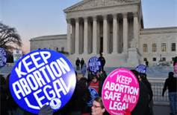
Roe vs. Wade
Addressed the rights of women to choose whether to have an abortion under certain circumstances.
By expanding the constitutional right of privacy to abortion, the Court extended civil liberties protections.

Slide 47
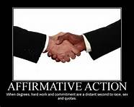
Regents of University of California vs. Bakke
Supreme Court ruled that race can be used when considering applicants to colleges, but racial quotas cannot be used.
The Court barred the use of quota systems in college admissions but expanded American’s civil rights by giving constitutional protection to affirmative action programs that give equal access to minorities.

Slide 48
Nixon and Ford Administrations
Richard Nixon’s presidency was one of great successes and criminal scandals.
Nixon’s visit to China in 1971 Nixon hoped to have the Chinese on his side in case he had future negotiations with the Soviets.
Later, Nixon was part of the Watergate scandal, which centered on his administration’s attempt to cover up a burglary of the offices of the Democratic Party in the Watergate apartment and office complex in Washington, D.C.
Nixon won reelection in 1972, but his efforts to cover up the crime soon unraveled and, facing impeachment, he resigned in 1974.
It also led to changes in campaign financing and to laws requiring high-level government officials to disclose
their finances.

Slide 49
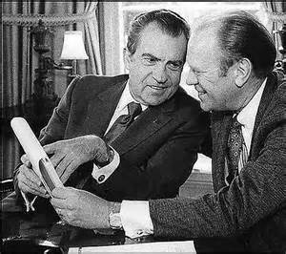
Nixon was succeeded by his vice president, Gerald Ford, whose two-year presidency was damaged by his connection to Nixon.
It was further damaged when he pardoned Nixon for any crimes he may have committed.
One bright spot is that the Vietnam War ended during the Ford administration.
Ford’s domestic policies failed to stop growing inflation and unemployment, and America experienced its worst economic recession since the Great Depression.

Slide 50
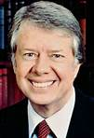
Carter Administration
Jimmy Carter’s presidency was strongly influenced by international issues.
He tried to bring peace to the Middle East and, in the Camp David Accords, negotiated a peace agreement between the Egyptian president and the Israeli prime minister at Camp David (a presidential retreat in Maryland) in 1978.
This was the first time there had been a signed peace agreement between Middle Eastern nations.
When Carter let the shah enter the United States for medical treatment, angry Iranian revolutionaries invaded the U.S. embassy in Iran and took 52 Americans captive.
The Iranian hostage crisis lasted 444 days.

Slide 51
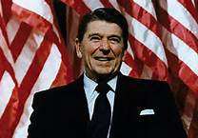
Reagan Administration
Ronald Reagan was president for much of the 1980s.
During that time, many important events helped shape American politics to this day.
As a conservative, Reagan wanted to decrease the size and role of the federal government.
Reaganomics was the nickname for Reagan’s economic policy.
It included budget cuts, tax cuts, and increased defense spending.
By cutting social welfare budgets, his policy hurt lower-income Americans and, overall, Reaganomics led to a severe recession.

Slide 52
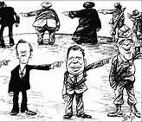
The Iran-Contra scandal was Reagan’s biggest failure in international policy.
Administration officials sold weapons to Iran––an enemy of the United States–and then violated more laws by using the profits from those arms sales to fund a rebellion in Nicaragua fought by rebels called the Contras (a Spanish nickname for “counter-revolutionaries”).
Details of this scandal are still largely unknown to
the public.

Slide 53
The collapse of the Soviet Union was Reagan’s biggest success in international policy.
The Soviet Union’s last leader set up policies allowing freedom of speech, freedom of the press, and other reforms, putting the U.S.S.R. on a path to democratic government.
These reforms got out of the leader’s control and eventually led to the breakup of the 15 states that were the Soviet Union.
Five of those states now comprise Russia, and the other ten are independent countries.

Slide 54
Clinton Administration
Bill Clinton’s presidency included ratification of the North American Free Trade Agreement.
NAFTA brought Mexico into a free-trade (tariff-free) zone already existing between the United States and Canada.
Opponents believed NAFTA would send U.S. jobs to Mexico and harm the environment, while supporters believed it would open up the growing Mexican market to U.S. companies; these pros and cons are still argued today.

Slide 55
Clinton also became the second president in U.S. history to suffer impeachment.
The House of Representatives charged him with perjury and obstruction of justice.
The charges were based on accusations of improper use of money from a real estate deal and allegations he had lied under oath about an improper relationship with a White House intern.
Clinton denied the charges and the Senate acquitted him, allowing Clinton to remain in office and finish his second term.

Slide 56
2000 Presidential Election
The presidential election of 2000 saw vice president, Al Gore, facing the Republican governor of Texas, George W. Bush.
Polls showed the race would be close, and it turned out to be one of the closest elections in American history.
Gore won the national popular vote, but the national popular vote has no legal significance.
Rather, Americans are voting for members of the Electoral College representing each candidate.
In the 2000 election, Bush won by receiving 271 votes in the Electoral College to Gore’s 266.

Slide 57
Bush Administration
George W. Bush’s presidency will always be remembered for al-Qaeda’s attacks on September 11,2001 (9/11).
Bush signed a law the next month to allow the U.S. government to hold foreign citizens suspected of being terrorists for up to seven days without charging them with a crime.
This law also increased the ability of American law-enforcement agencies to search private communications and personal records.
Then he created the Department of Homeland Security and charged it with protecting the United States from terrorist attacks and with responding to natural disasters.

Slide 58
In October 2001, another of Bush’s responses to the 9/11 terrorist attacks was his authorizing Operation Enduring Freedom.
Operation Enduring Freedom was the invasion of Afghanistan by the U.S. military and allied forces.
That country’s Taliban government was harboring the al-Qaeda leadership.
The allied forces quickly defeated the Taliban government and destroyed the al-Qaeda network in Afghanistan.
The al-Qaeda leader Osama bin Laden escaped.

Slide 59
The invasion of Afghanistan was part of Bush’s war on terrorism.
He built an international coalition to fight al-Queda and other terrorist groups.
March 2003, American & British troops invaded Iraq in Operation Iraqi Freedom.
Iraq’s President Sadam Hussein, went into hiding.
Bush claimed Iraq had weapons of mass destruction (WMD).
No WMD were ever found.
Hussein was captured and convicted of crimes
against humanity and executed in 2006.

Slide 60
THE END
Good Luck on the E.O.C.T!!!

